Slide 1
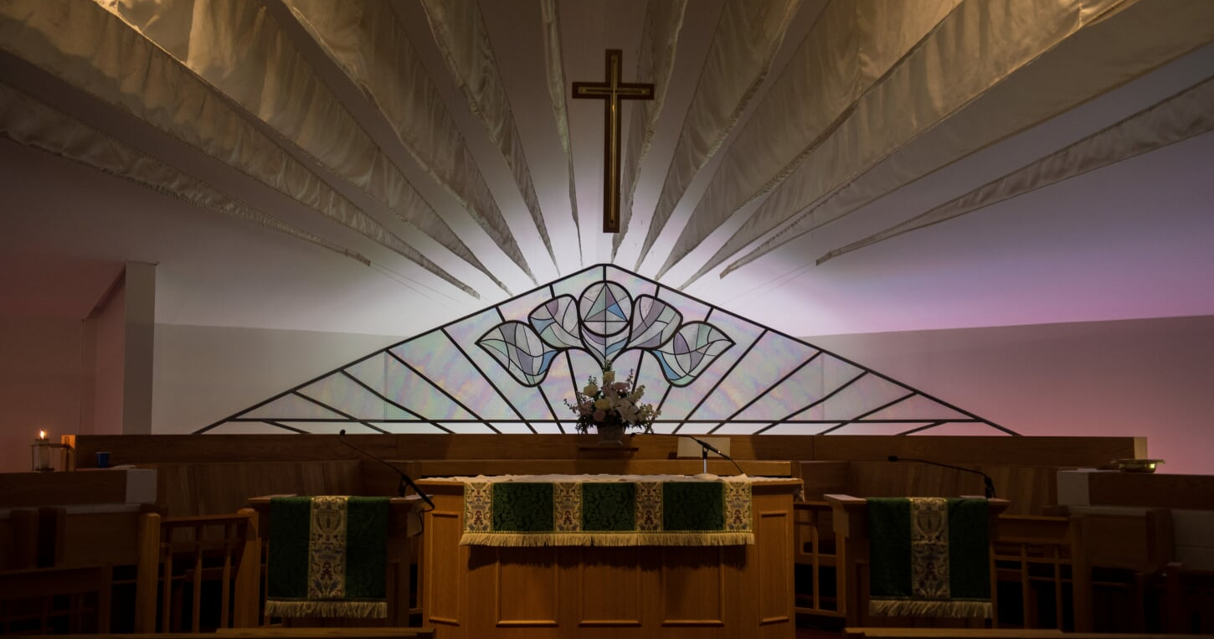
St. Timothy’s Anglican Community
Parish Retreat at Shrine Mont
September 2021 (Revised March 2023)

Slide 2
Overview
St. Timothy’s Episcopal Church is the center of our personal faith community.
We are one part of The Anglican Communion. How can we engage in the broader faith community to live into the Ministry of the Laity?

Slide 3
Ministry of the Laity
The ministry of lay persons is to represent Christ and His Church; to bear witness to Him wherever they may be and, according to the gifts given them, to carry on Christ’s work of reconciliation in the world; and to take their place in the life, worship, and governance of the Church.

Slide 4
AGENDA
The Big Picture
St. Timothy’s Church
North Fairfax Region
Diocese of Virginia
Province III
The Episcopal Church
The Anglican Communion

Slide 5
THE BIG PICTURE

Slide 6
Anglicanism
The Anglican Communion
Province III
Diocese of Virginia
North Fairfax Region
St. Timothy’s Parish
The Episcopal Church
A worldwide body of Christians responding to God’s revelation through Jesus Christ.
Anglicanism brings together the authority of the Bible, the historic faith, and the beauty of structured prayer. It is rooted in tradition, yet contemporary in practice. It is united in substance, yet diverse in expression.
We are a global family living out our faith in local communities.
6

Slide 7
St. Timothy’s Episcopal Church

Slide 8
St. Timothy’s Episcopal Church
At a Glance
Opportunities for Ministry
Mission: To restore all people to unity with God and each other in Christ
Governance:
Ordained: Rector (Appointed by Vestry; Confirmed by Bishop), Priest-in-Charge (Joint Discernment by Vestry and Bishop), Curate (Appointed by Rector)
Lay: Vestry (Elected by Congregation)
Established in 1868
Serving the Herndon / Reston communities through programs and partnerships
Membership: 619*
Average Sunday Attendance (ASA): 73*
Annual Plate & Pledge: $515,884*
Worship & Music
Children & Youth
Christian Education & Formation
Hospitality / Outreach
Vestry / Lay Leadership / Lay Delegate
Building & Grounds
Stewardship & Finance
Operations
Whatever needs to be done . . .
* Source: The Episcopal Church Demographic Tool “Data Story Cloud”; data as of 2021
Learn More: https://www.saint-timothys.org/

Slide 9
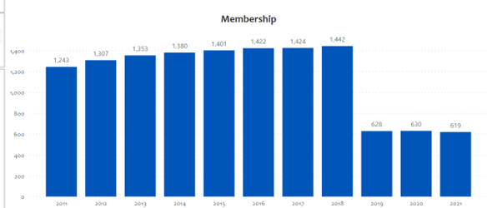
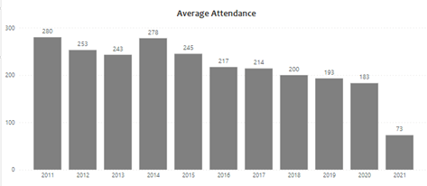
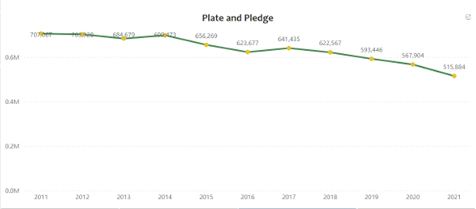
St. Timothy’s Trends
Source: The Episcopal Church Demographic Tool “Data Story Cloud”
Source: The Episcopal Church Demographic Tool “Data Story Cloud”

Slide 10
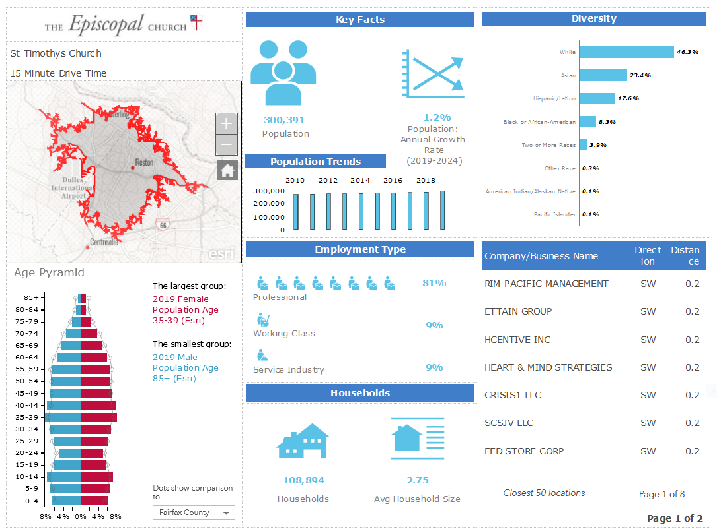
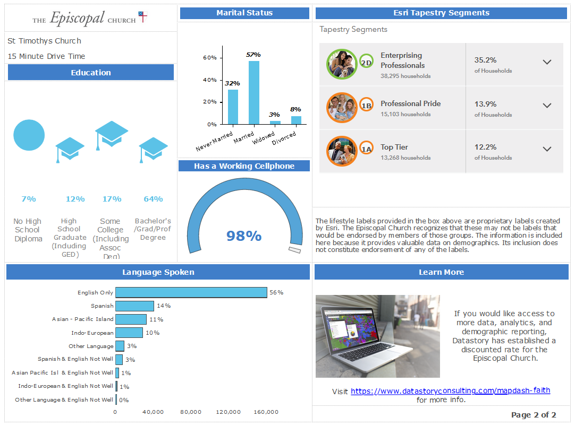
St. Timothy’s Community
Source: The Episcopal Church https://datastorycloud.com/episcopal/publicviewerloud”
Source: The Episcopal Church Demographic Tool “Data Story Cloud”

Slide 11
North Fairfax Region

Slide 12
North Fairfax Region
At a Glance
Mission: To collaboratively leverage resources from the represented congregations to better serve the people in the North Fairfax County Region
Governance:
Ordained: Dean (Appointed by Bishop)
Lay: Officers (Elected by Region Council) - President, Vice President, Secretary, Treasurer
Region Representative to Diocesan Executive Board: Alternating Ordained / Lay (Elected by Region Council)
One of 16 geographically-oriented Regions in the Episcopal Diocese of Virginia
Includes 10 congregations who collaboratively identify priorities and programs to support financially through a Region budget totaling about $6,000 per year
Lay representation of each congregation to the Region Council and to the Diocesan Annual Convention is based upon ASA
St. Timothy’s is authorized two Lay Delegates – Currently Tom & Betsy Bosworth; Alternate Kent Miller
Region Council meets four times per year, rotating meeting location among parishes; Clericus meets monthly
Learn More: The Lay Delegate Guide

Slide 13
North Fairfax Region
Opportunities for Ministry
Be a conduit of information between St. Timothy’s and the Region / Diocese
After each meeting, prepare notes to share with St. Timothy’s members about events and opportunities for their participation
Share information about St. Timothy’s upcoming events to which others are invited
Serve as Officer (President, Vice President, Treasurer, Secretary) for one-year term
Participate in Region Life Committee to coordinate events in the community; start up new activities inspired by your passion
Support Moving Mountains Youth Mission Trip to Southwest Virginia
Maintain Region Portal
Interface with the Diocese for speakers on Diocesan programs and priorities
Learn More: The Lay Delegate Guide

Slide 14
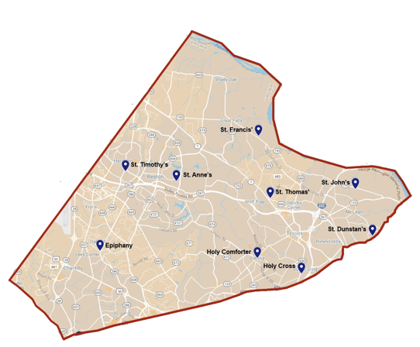
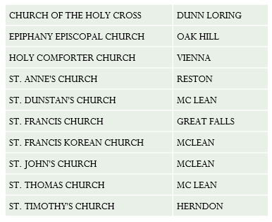
North Fairfax Region
Members: 6,574
ASA: 844
Pledge & Plate: $5,794,277

Slide 15
The Episcopal Diocese of Virginia

Slide 16
Diocese of Virginia
At a Glance
Largest Diocese in The Episcopal Church in the United States; HQ is Mayo House in Richmond
Congregations: 180 Parishes + Missions
Members: 67,042
ASA: 20,750
Pledge & Plate: $60,002,800
Canonically-Resident Clergy: 425
Two Conference and Retreat Centers
Six Church Schools
Six Diocesan Homes
Ten Related Organizations
25+ Committees and Commissions
Largest Anglican Seminary in the World - VTS
Vision: Our eyes fixed on Jesus, we speak the truth and act in love for the transforming of lives and the healing of the world.
Mission Priority Areas:
Healing across differences
Honoring and caring for God’s creation
Sharing the faith of Jesus
Governance:
Ordained: Bishop Diocesan (Elected by Convention Delegates; Consent by Standing Committees; Confirmed by Presiding Bishop); Bishop Suffragan (Elected by Convention Delegates); Assistant Bishops, Archdeans and Deans (Appointed by Bishop Diocesan / Ecclesiastical Authority)
Standing Committee: Ordained and Lay (Elected by Convention Delegates)
Lay: Executive Board (Elected by Region Councils)
Constitutions and Canons
Annual Convention
Learn More: thediocese.net

Slide 17
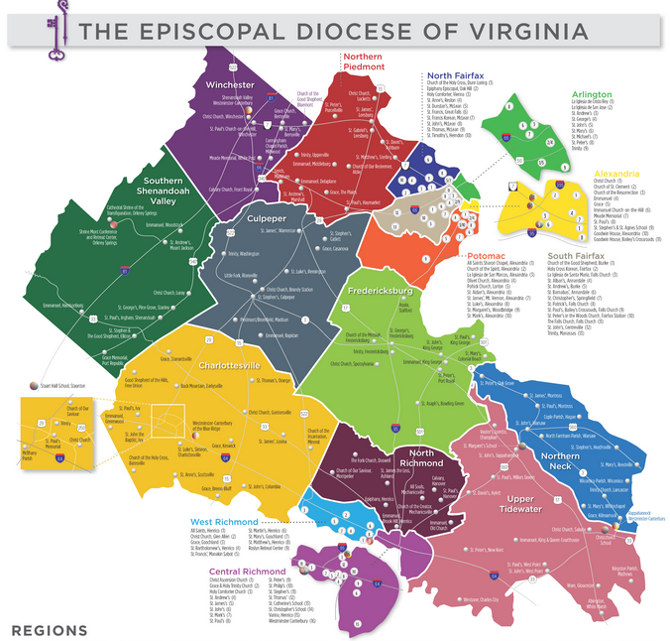
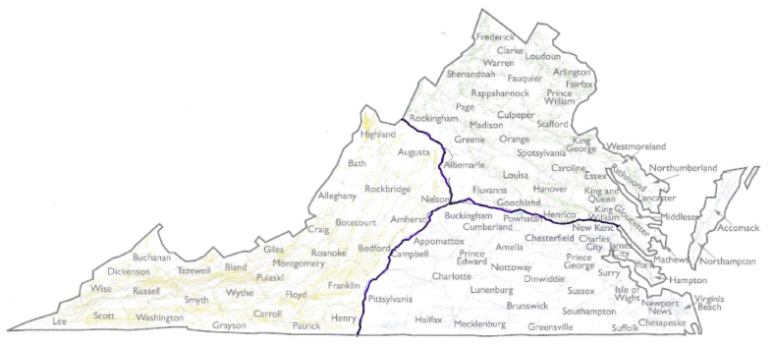
The Episcopal Diocese of Virginia
Diocese of Virginia
Diocese of Southwestern Virginia
Diocese of Southern Virginia

Slide 18
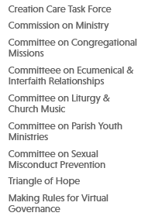
Diocese of Virginia
Related Organizations
Commissions & Committees
Opportunities for Ministry
Attend Annual Diocesan Convention as non-voting member
Participate in Committees and Commissions of the Diocese
Apply for the Transition Committee for the Bishop Diocesan Search
Learn More: thediocese.net

Slide 19
Province III

Slide 20
Province III
At a Glance
Opportunities for Ministry
Goal: to encourage a forum for the sharing of programs, resources and ministries in such a way as to develop effective strategies for coordinating and enhancing the use of regional and national resources
Governance: Provincial Synod
One of 9 Provinces, includes 13 Dioceses and 1,187 Parishes
Each Diocese is represented by Ordained and Lay elected by Diocesan Annual Convention Delegates
Synod meets annually in May; Council meets annually in October
Coordinated Ministries:
Altar Guild
Anti-Racism Awareness and Training
Campus Ministries
Christian Formation
Ecumenical Affairs
Environmental Stewardship
Lay Delegate to Province III
Episcopal Church Women
Health Ministries (includes Opioid Task Force)
Peace & Justice
Vocations Ministry
United Thank Offering
Youth Ministry
Learn More: https://www.province3.org/

Slide 21
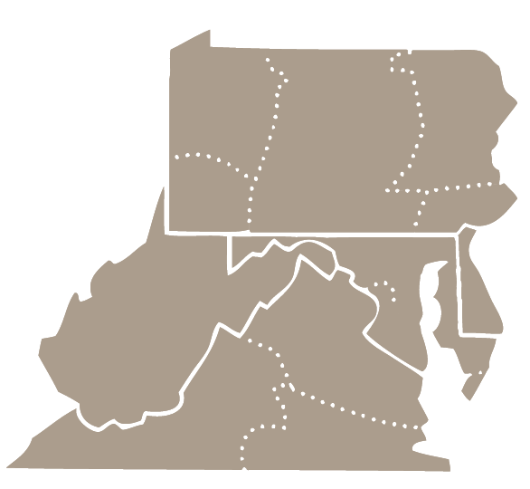
Province III
Dioceses in Province III
Bethlehem
Central Pennsylvania
Northwestern Pennsylvania
Pennsylvania
Pittsburgh
Virginia
Southern Virginia
Southwestern Virginia
Washington
West Virginia
Delaware
Easton
Maryland
Learn More: https://www.province3.org/

Slide 22
The Episcopal Church

Slide 23
The Episcopal Church
At a Glance
Opportunities for Ministry
Mission: “to restore all people to unity with God and each other in Christ.”
Priorities:
Evangelism
Reconciliation
Creation Care
Governance:
The Presiding Bishop and Primate – The Most Reverend Michael B. Curry (Elected by General Convention) in 2015
General Convention - 80th General Convention July 2022
House of Bishops ~ 300 members
House of Deputies ~ 800 representatives
Executive Council
Constitution and Canons
Founded 1785 with headquarters in New York City
1.8M Members
111 dioceses and regional areas in 17 nations
10 Episcopal Seminaries
Lay Delegate to General Convention. The 81st General Convention of The Episcopal Church will be held in July 2024 in Louisville, Kentucky (Episcopal Diocese of Kentucky).
Explore the many resources for education, spiritual development and ministry on TEC website – videos, podcasts, sermons, The Way of Love practices . . .
Learn More: https://www.episcopalchurch.org/

Slide 24
The Episcopal Church
Learn More: https://www.episcopalchurch.org/

Slide 25
The Anglican Communion

Slide 26
The Anglican Communion
At a Glance
Opportunities for Ministry
The Five Marks of Mission:
To proclaim the Good News of the Kingdom
To teach, baptise and nurture new believers
To respond to human need by loving service
To transform unjust structures of society, to challenge violence of every kind and pursue peace and reconciliation
To strive to safeguard the integrity of creation, and sustain and renew the life of the earth
No central government, but loosely linked by four “instruments” of communion:
The Archbishop of Canterbury - The Most Reverend and Right Honorable Justin Welby
Lambeth Conference (named for HQ Lambeth Palace in London)
Primates’ Meeting
Anglican Consultative Council
The Anglican Communion is the third-largest Christian body in the world:
165 Countries
41 Provinces and 5 Extra-provincial Areas
Over 80 million members
Joining the Episcopal Church automatically makes you a member of the Anglican Communion.
When travelling, worship at another Anglican Communion church . . . you’ll feel right at home!
Learn More: anglicancommunion.org

Slide 27
The Anglican Communion
Learn More: anglicancommunion.org

Slide 28
SUMMARY
What can we each do to take our place in the life, worship, and governance of the Church?

Slide 29
THANK YOU!
Diane Miller

